Slide 1
Managing Your Discrete Manufacturing – Project Manufacturing

Slide 2

Managing Your Discrete Manufacturing – Project Manufacturing
Toon Six, Internet Customer Solutions
We’ll walk you through a business case showing the possibilities in a Project Manufacturing process using Acumatica Project Accounting and Acumatica Manufacturing Edition.
ToonSix@Intercs.com
www.intercs.com
C: 973 727 9665
Nov. 5, 2020
Notes:
Project manufacturing cases:
Producing a trades show booth
Building a commercial lighting system for an office building, a department store, university,..
Setting up a robot for the customer
Setting up 3D printers
Manufacturing a storage system (conveyors, sorting stations, put to light system) for a warehouse
Installing the electricity in a large building
Construction: building a house, commercial building, HVAC in a large building
Manufacturing a custom machine/equipment

Slide 3
Agenda
What is Discrete Manufacturing – Project Manufacturing?
Project Example: Install a trade exhibition booth for Sanding Robot Company
Solution: Project Management Steps in Acumatica
Demo
Q&A

Slide 4
What is Discrete Manufacturing – Project Manufacturing
Project consists of:
Labor (CAD, engineering, project management, packing, loading, transport, unloading, ..)
Parts
  Finished good to be manufactured:
    Material/Components to be purchased
    Sub-assembly to be manufactured
    Labor, tools, machines, overhead
  Parts to be purchased/rented

Slide 5
Project Example: Install a trade exhibition booth for Sanding Robot Company
Project consists of:
Labor (CAD, engineering, project management, packing, loading, unloading, ..)
Parts
  Finished good to be manufactured: trade booth – injection molding machine (?). Better major panel (picture )
    Materials/Components to be purchased
    Labor, tools, machines, overhead
  Parts to be purchased/rented

Slide 6

Solution: Project Management Steps in Acumatica
Acumatica Distribution Suite
  Order and Inventory management
    Set up stock and non-stock items
CRM Opportunity
  Project quote. Convert it to a project.
Project Accounting
  Project
    Labor: CAD, ..
    Part: finished good (injection molding machine or trade booth panel to be manufactured)
Manufacturing of Injection Molding Machine
  Make To Order (MTO)
    BOM
    Production Order Planning
    Production Management: actuals
Project Accounting
  Project Revenue and Costs (budgeted versus actuals)
@acu_connect

Slide 7
DEMO
Screen captures of webinar that was given by Jessica Gadbois, Presales, Acumatica
Webinar: https://www.intercs.com/acumatica-project-manufacturing
@acu_connect

Slide 8
Demo: Inventory Management and CRM Opportunities
Acumatica Distribution Suite
  Order Management
    Set up non-stock items: labor, services
  Inventory Management
    Set up stock items
CRM: Opportunity
  Create a project quote using the Acumatica Advanced Manufacturing Management Application – Estimator
    Estimator creates a Bill Of Material (BOM)
    (https://www.intercs.com/acumatica-advanced-manufacturing )
  If quote is approved by the customer, convert project quote to a project
@acu_connect
Notes:
CRM: Opportunities: https://www.intercs.com/acumatica-crm-lead-opportunity
In the Estimator, you enter all the details such as work centers, operations, materials, machines used, tools and overhead, This enables you to create a project quote. If the project quote is approved by the customer, you can convert the project quote into a project.
From the Estimator, you can create a Bill Of Material.
See: https://www.intercs.com/acumatica-advanced-manufacturing

Slide 9
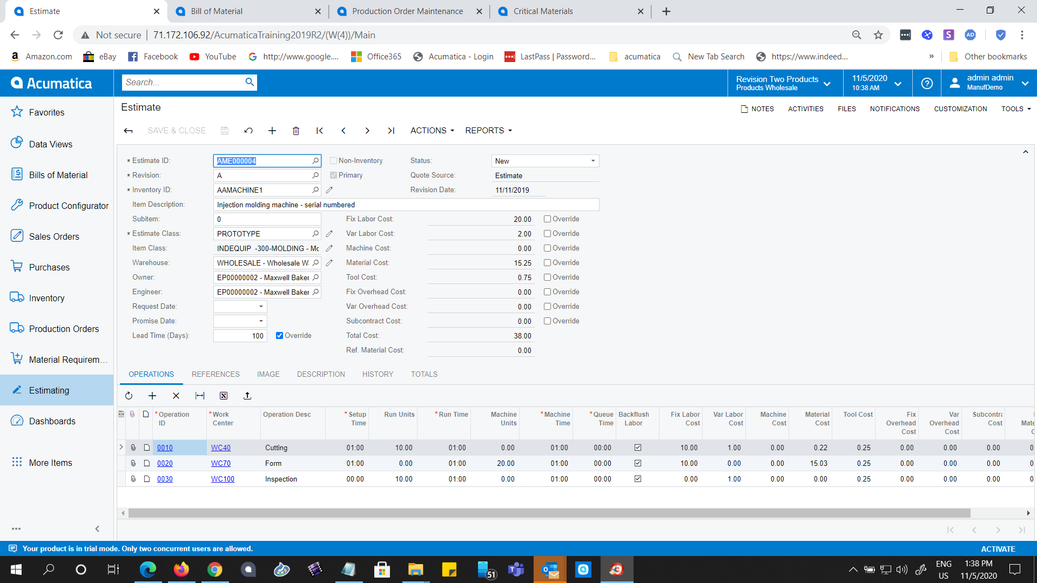
Demo: Manufacturing Management – Estimate
@acu_connect

Slide 10
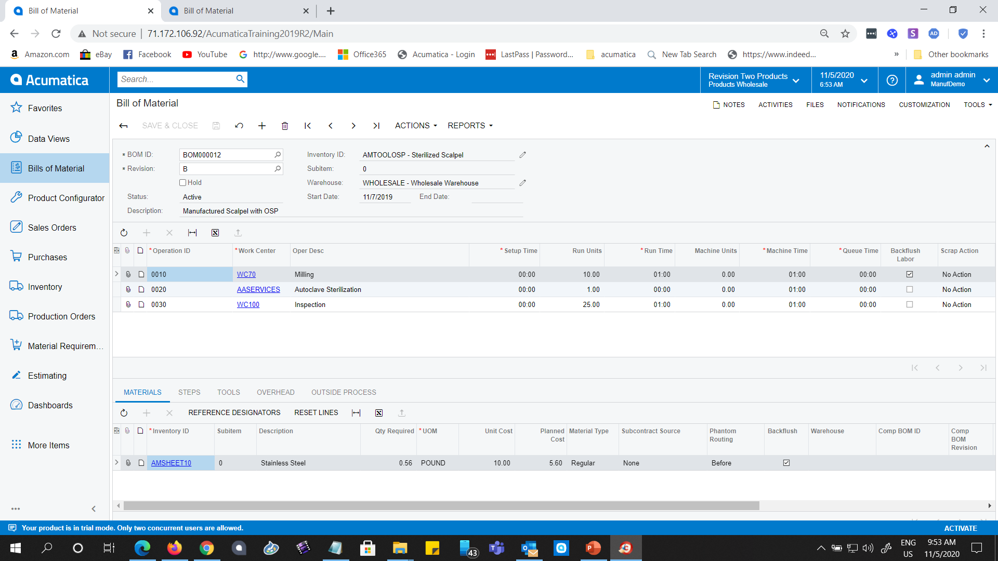
Demo: Manufacturing Management – Bill of Material
@acu_connect

Slide 11
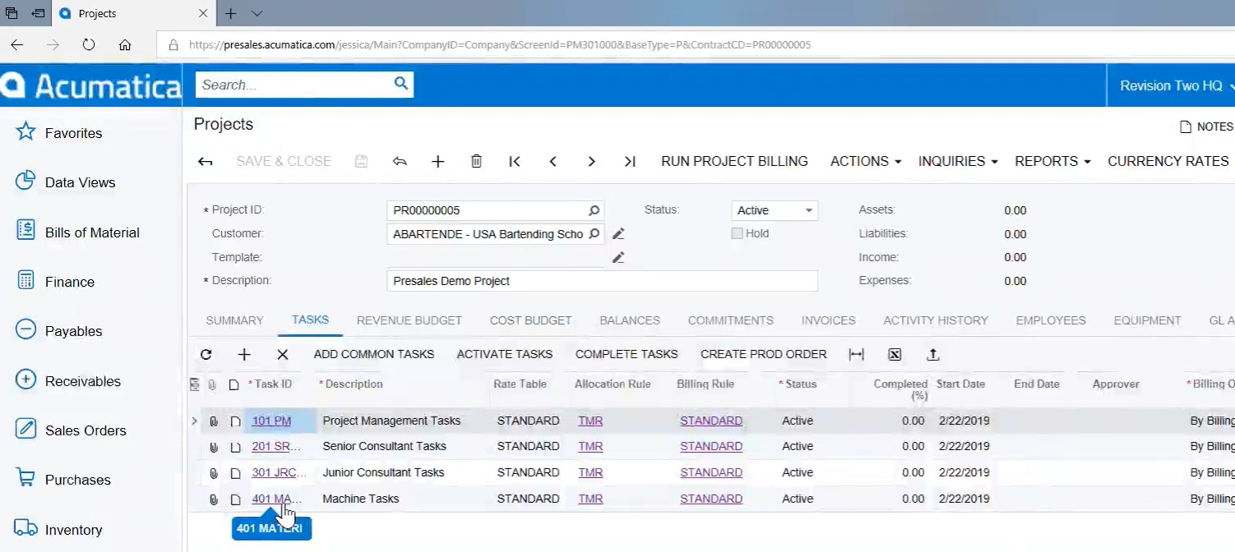
Demo: Project Accounting – Machine Tasks
@acu_connect

Slide 12
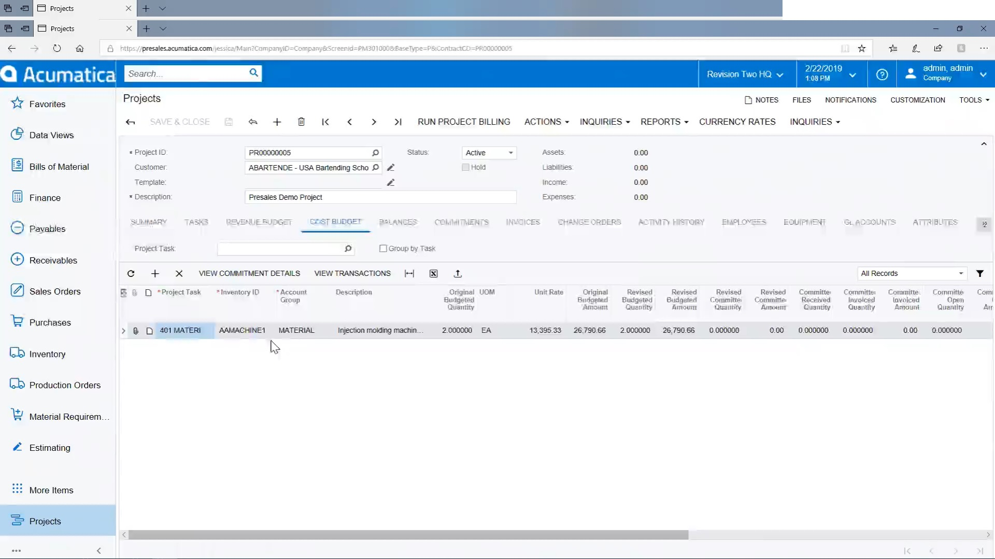
Demo: Project Accounting
Set up project:
Labor: CAD, ..
Part: finished good (trade booth panel to be manufactured)
@acu_connect
Notes:
Project – Cost budget – project task: 401 materials (machine tasks)
Budgeted Amount: $13,395, could have been created from the Manufacturing Advanced Management application: Estimator
In the Estimator, you enter all the details such as work centers, operations, materials, machines used, tools and overhead, you can create a Bill Of Material from it.
See: https://www.intercs.com/acumatica-advanced-manufacturing

Slide 13
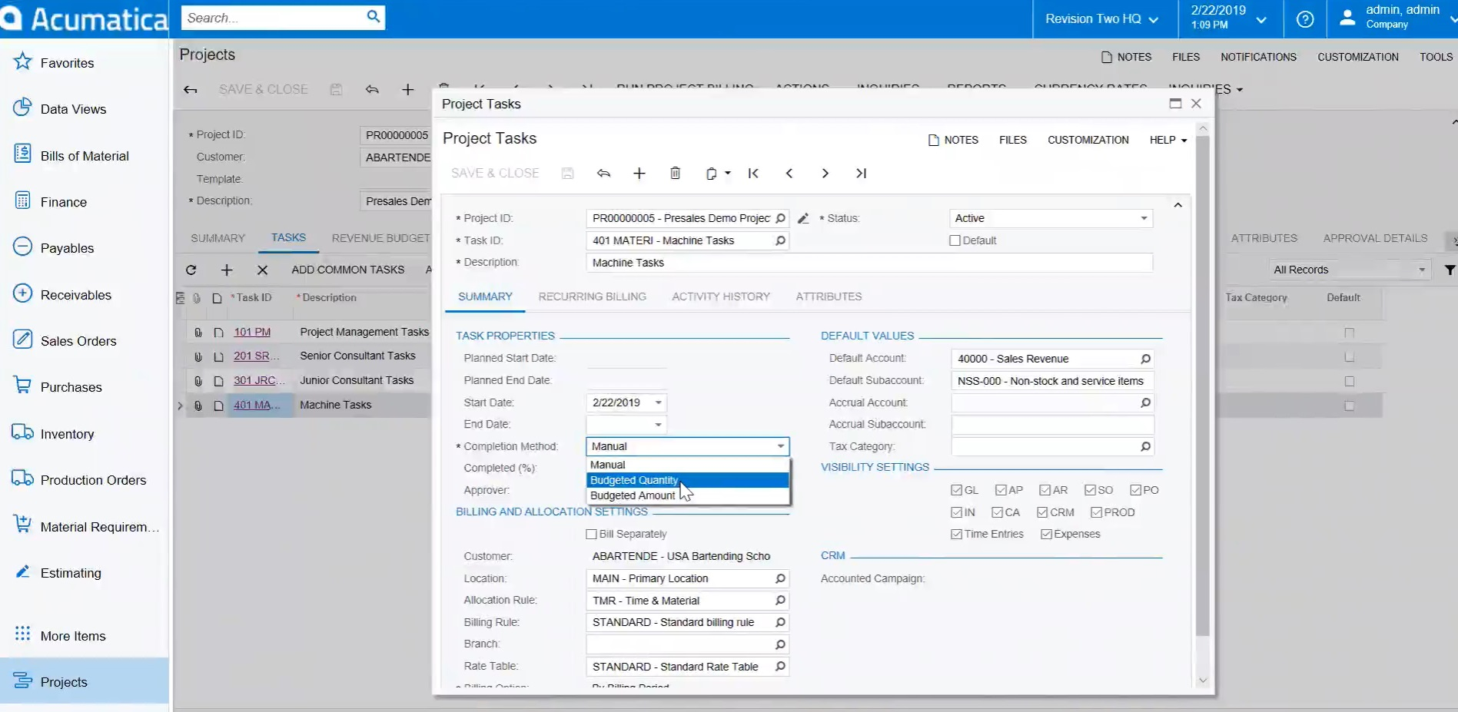
Demo: Project Accounting – Machine Task Completion Method
@acu_connect
Notes:
Project task: Machine tasks – completion method

Slide 14
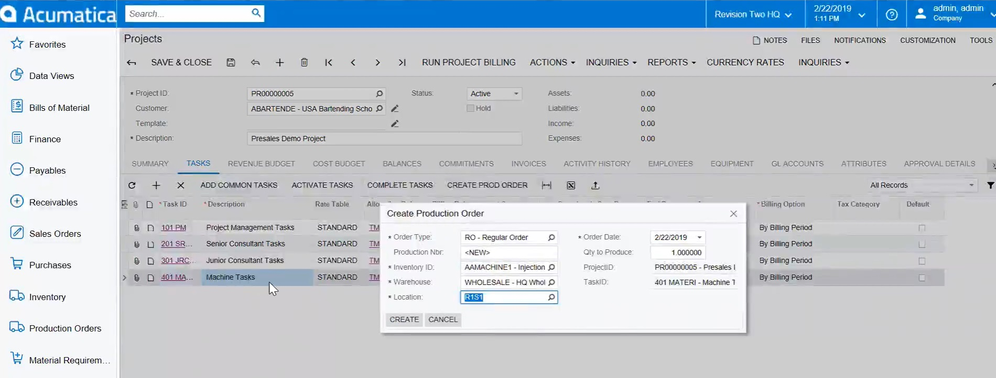
Demo: Project Accounting – For Machine Task, Create a Production Order
@acu_connect
Notes:
For a machine tasks, create a production order
If a production order was created from a project task that includes a product to be manufactured, a BOM must have been created previously for that product.

Slide 15
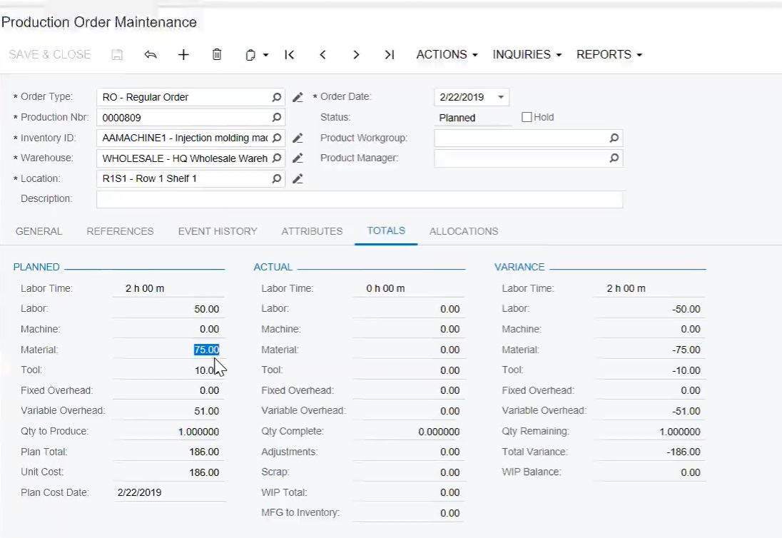
Demo: Manufacturing Management App. – Production Order Total Costs
@acu_connect

Slide 16
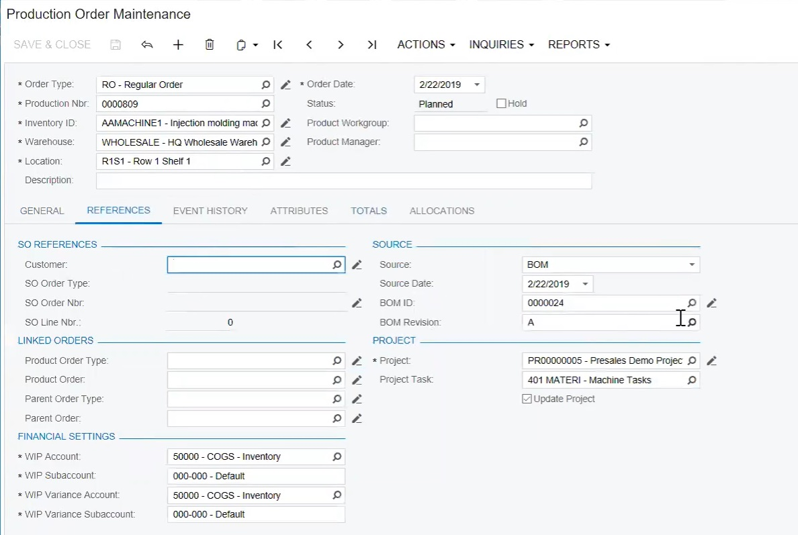
Demo: Manufacturing Management App. – Production Order Link to BOM
@acu_connect
Notes:
Planned Production Order: link to Bill Of Material, that has to be built prior

Slide 17
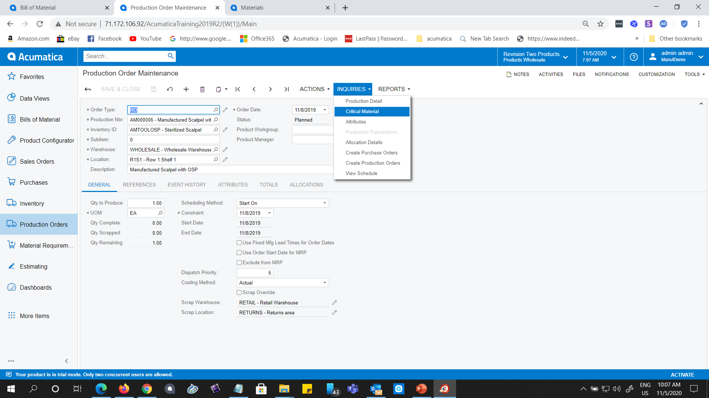
Demo: Manufacturing Management App. – Production Order Release– Inquiry about shortage of materials (critical materials)
@acu_connect
Notes:
Check for shortage of materials (critical materials) before you release the production order

Slide 18
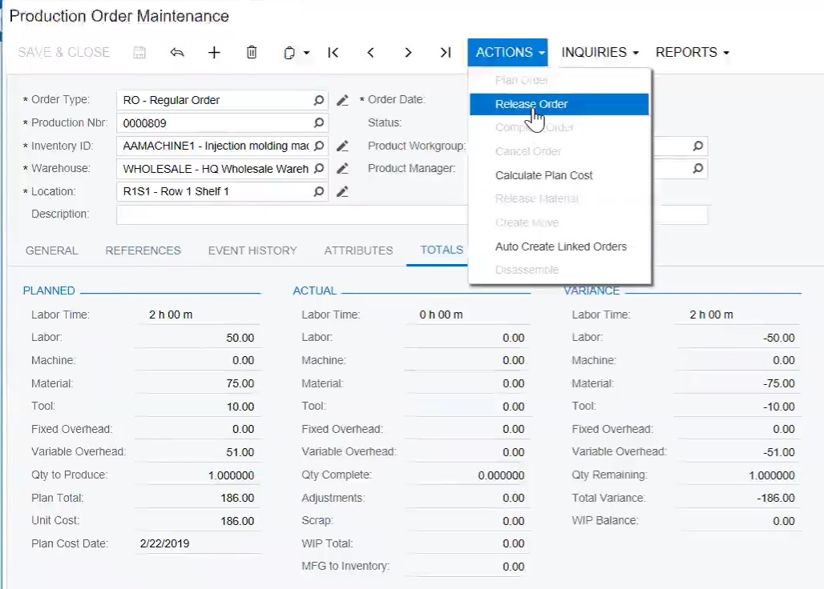
Demo: Manufacturing Management App. – Production Order Release
@acu_connect
Notes:
Assuming that all required materials, labor, machine capacity and tools are available. Basically assuming infinite labor and machine capacity. No MRP was run in this case to determine shortages of materials and to determine when to order materials and to start the production. This is a typical MTO manufacturing method. Since there is no forecast of the demand for the injection molding machine, and since the specs of the machine are not known before the sales order or project request came in, the MTO manufacturing method is the best solution.
Alternatively you could run the MRP to determine the above. Then, you would be using the MTS manufacturing method. Your demand would consist of only this sales order/project request.
Release production order

Slide 19
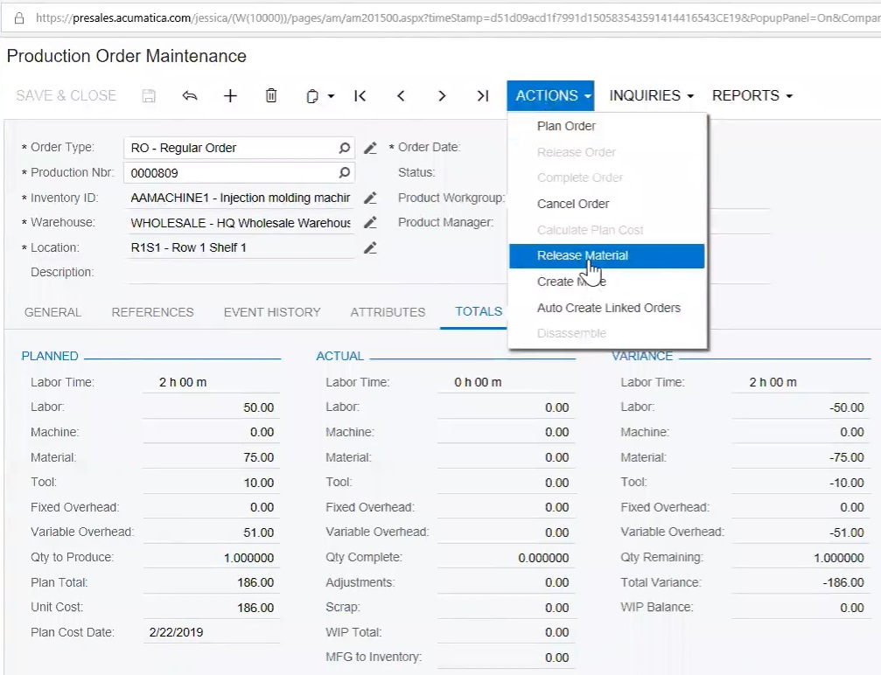
Demo: Manufacturing Management App. – Production Order: Release Material
@acu_connect
Notes:
Now release the materials needed for this production order

Slide 20
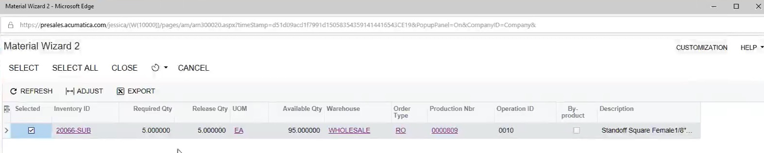
Demo: Manufacturing Management Application – Production Order:
All Materials Released
@acu_connect
Notes:
The material wizard 2 checks the availability of the materials. If available, the materials will be released.

Slide 21
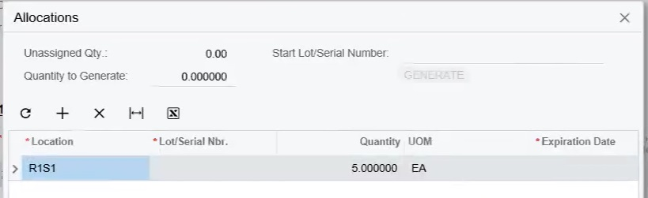
Demo: Manufacturing Management Application – Production Order:
Purchased Material Allocated to a Production Order
@acu_connect
Notes:
It is possible to allocate purchase orders to a particular production order.

Slide 22
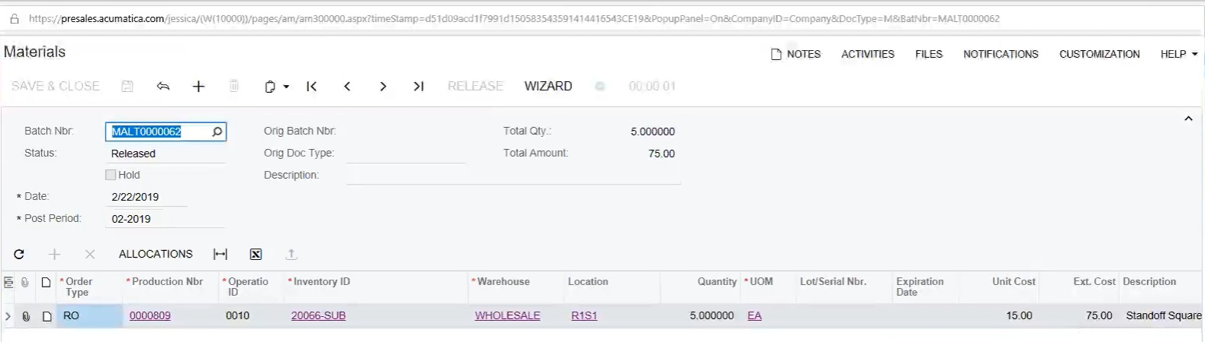
Demo: Manufacturing Management Application – Production Order:
All Materials That Have Been Released, and Their Costs
@acu_connect
Notes:
All materials have been released for this production order. See the total cost of $75.

Slide 23
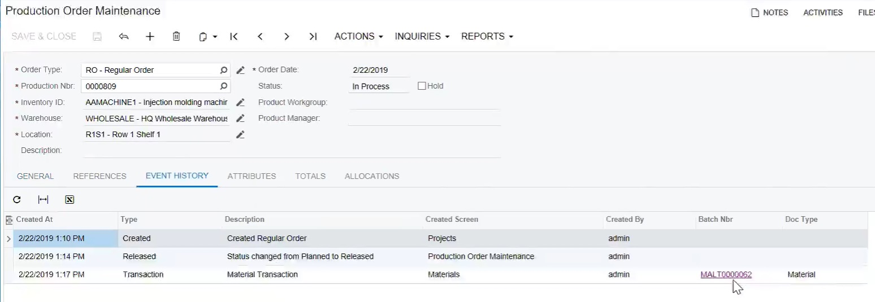
Demo: Manufacturing Management Application –
Production Order: Event History
@acu_connect

Slide 24
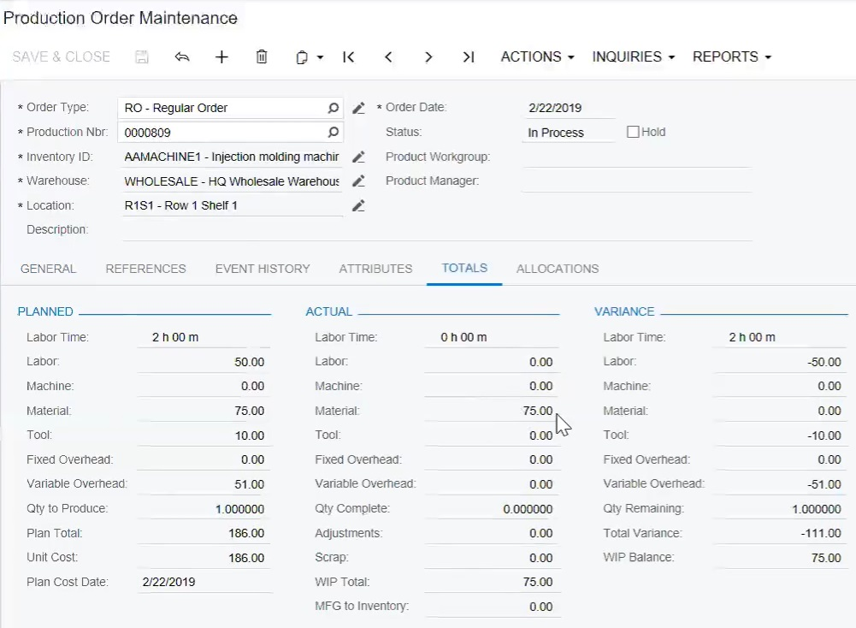
Demo: Manufacturing Management Application –
Production Order: Actual Costs Updated
@acu_connect

Slide 25
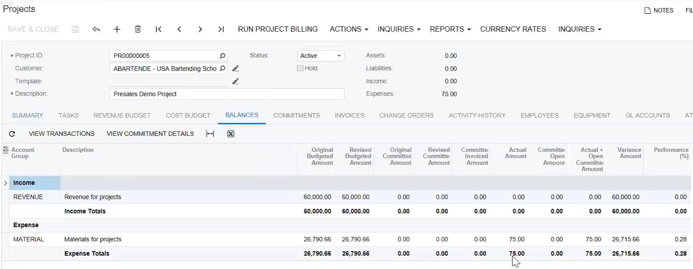
Demo: Project Accounting –
Actual Costs Updated
@acu_connect

Slide 26
Questions?

Slide 27
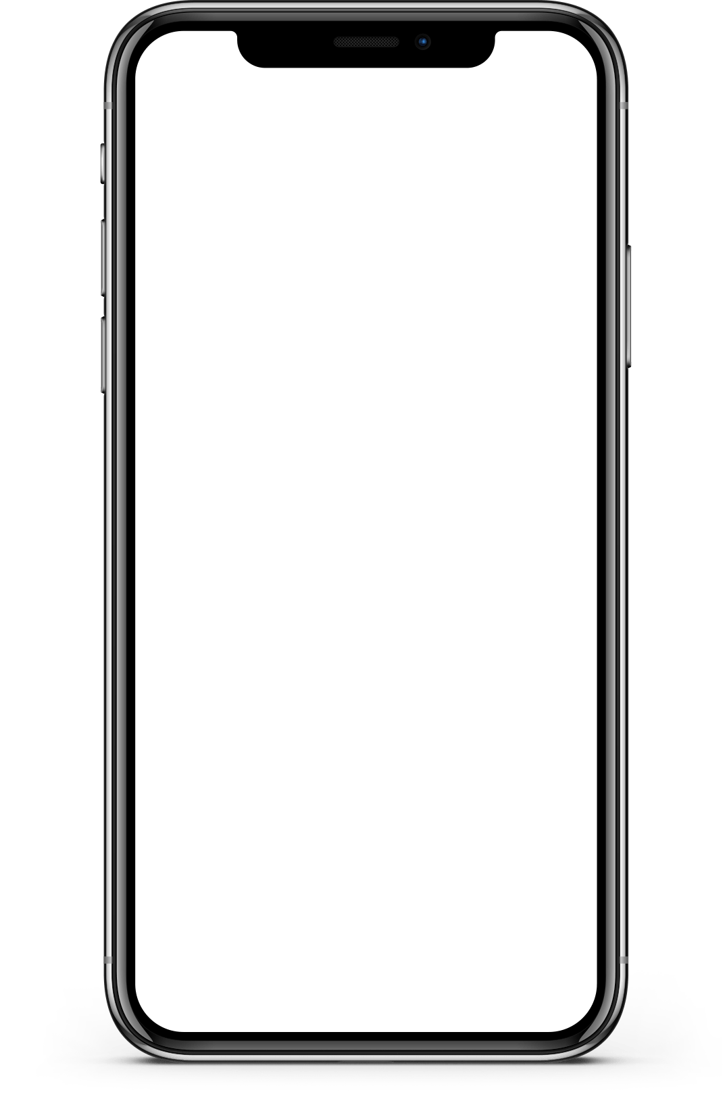
Session Takeways
Full integration of Project Accounting and Discrete Manufacturing Application. No more Excel sheets needed between the two systems. Saving money.
Profitability of a project is seen right away. Drill down for problem analysis. Faster problem detection and resolution, which can save tons of money
Flexibility regarding actuals (backflush or manual) and MTO vs MTS, or both. That is powerful, and enables great control of progress status.
https://www.intercs.com/acumatica-project-manufacturing
Thank you for attending!
Toon Six
ToonSix@intercs.com
C: 973 727 9665
www.intercs.com

